Slide 1
Where To Live After Graduation?
Chad Goss | Sean Liberati | Andrew Sicker

Slide 2
The Idea
Many students do not know what city they want to live in after graduation
Most students prioritize the job they are seeking over the city they live in
What if by answering a few simple preference questions you knew which city best fit your personality and could hone in your job search?

Slide 3
What We Did
Cities considered
Atlanta
Austin
Boston
Chicago
Cincinnati
Cleveland
Columbus
Dallas
Denver
Houston
Indianapolis
Los Angeles
Louisville
Miami
Milwaukee
Minneapolis
Nashville
New Orleans
New York
Philadelphia
Pittsburgh
Portland, OR
San Diego
San Francisco
Seattle

Slide 4
What We Did
We began by identifying over 20 variables that we believed most people our age would care about when looking for a city:
Variable List
Unemployment Rate
Tax rate
Crime Rate
Number of Concert Venues
number of breweries
median 1 BR rent
AVG Temp (Jan)
AVG Temp (April)
AVG Temp (July)
AVG Temp (Oct)
Yearly AVG Temp
average rainfall
average snowfall
Presence of Sports Teams
Public Parks
Total Population
Age (25-34)
Population
Bar Density per 100k
Public Transportation

Slide 5
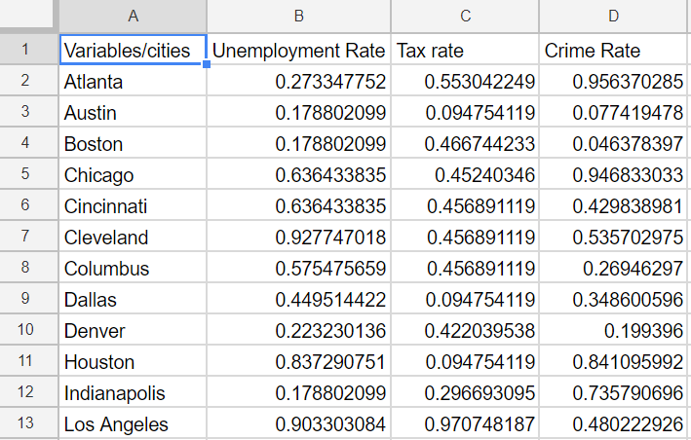
Scaling the Data
Since variables were in differing units, we scaled them all to be on a 0-1 scale (except the temperatures) and expressed them as percentile ranks

Slide 6
Imputation
For missing values in our data, we imputed the mean value for the that variable
Number of Concert Venues
Number of Breweries
Bar Density per 100k people
Time spent in traffic

Slide 7

Mathematical Model
Based on the parameters given above, the decision variables will be defined as:
X_{i,j} = Score for each city, i and and characteristic, j.
W_{j} = Assigned weight for each characteristic, j.
Y_{i} = Binary indicator variable equal to 1 for the city with the maximum score for each city, i.
With these decision variables, the objective function is as follows:

Slide 8
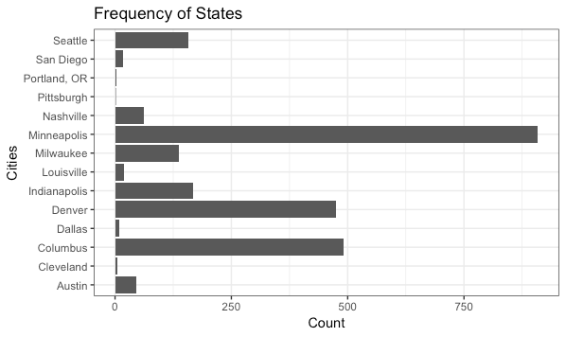
Simulations

Slide 9
APP DEMONSTRATION

